Slide 1

ECE 554 Final Project
Sega Master System
-TEAM ZOOP-
Clement Luk, Eric Jackowski, Ilhyun Kim, Mike Wiktor, Karthik Ramachandran, Tsung-Hao Chen, Tsung-Chi Lin, Yi-Ting Chen, Dan Luu

Slide 2
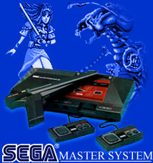

Slide 3


Outline
Features
CPU
Translator
Graphics
Memory & I/O devices
Emulator

Slide 4
Outline
Implementation
Problems & Difficulties encountered
Debug & Testing
Design Changes
Final Product

Slide 5
Features
Features
  On-the-fly CISC to RISC instruction translation
  Memory Paging
  Sega Emulation
  Interrupts

Slide 6

Z80 processor
CISC processor
  Variable length instruction(each are 1 byte length, max up to 4 bytes)
  16 bits address bus, 8 bits data bus
  Other signal to interface with I/O and memory
Register
  2 sets of 6 general register
    (8 bits or 16 bits as pairs)
  2 sets of accumulator and flag register
  Special registers:
    Program Counter, Stack Pointer, Index Reg, Interrupt Reg, Memory refresh Reg

Slide 7
Z80 Processor Instructions
Total 158 different types, but addressing mode can be mixed
  1) Load and exchange
  2) Block transfer and search
  3) Arithmetic and logical
  4) Rotate and shift
  5) Bit manipulation(Set, Rest, Test)
  6) Jump, call, and return
  7) Input/Output
  8) Basic CPU control

Slide 8
RISC Core
z80 compatible
  Emulates all architectural states
  Timing is not emulated
RISC implementation
  Single-issue pipelined core
  Load / Store architecture
Translating z80 instructions into micro-ops
  Reducing the complexity of the pipelined implementation of z80

Slide 9
Micro-op format
Instuction format
  RRR type: 15+6 bits
  RRI type: 18 +6 bits
  RI type: 21 +6 bits
op | Rdst(5) | Rs(5) | Rt(5)
op | Rdst(5) | Rs(5) | IMM(8)
op | Rdst/Rsrc(5) | IMM(16)

Slide 10
Processor Block Diagram
Memory
Memory
z80
fetch
xlate
decode
/
RF
access
EXE
stage
MEM
stage
instruction
queue
fetch / translator
RISC core

Slide 11
Instruction fetch / translation
z80 instruction fetcher
translator
pre-decode
logic
z80 I ready
pre-decode info
memory
system
xlator stall
z80
inst queue
8-bit
z80
inst word
16-bit
addr
fetch
PC
1
1~4 byte
z80 I-word
adder
target PC (from the core)
MUX
taken CTI/interrupt
(from the core)

Slide 12
Instruction fetch / translation
Instruction queue
uop[0]
xlator
FIFO queue0 (core gen)
decode
RF
uop[1]
FIFO queue1 (core gen)
uop
uop[2]
MUX
FIFO queue2 (core gen)
uop[3]
FIFO queue3 (core gen)
queue full
sequencing 0,1,2,3
Multi-input, single-output FIFO
Queue 4 uops in parallel (if <4 put nop)
Dequeue 1 uop sequentially from each queue
When instruction with EOI is dequed, dequeue nops from remaining queue’s and start dequeing from queue0

Slide 13
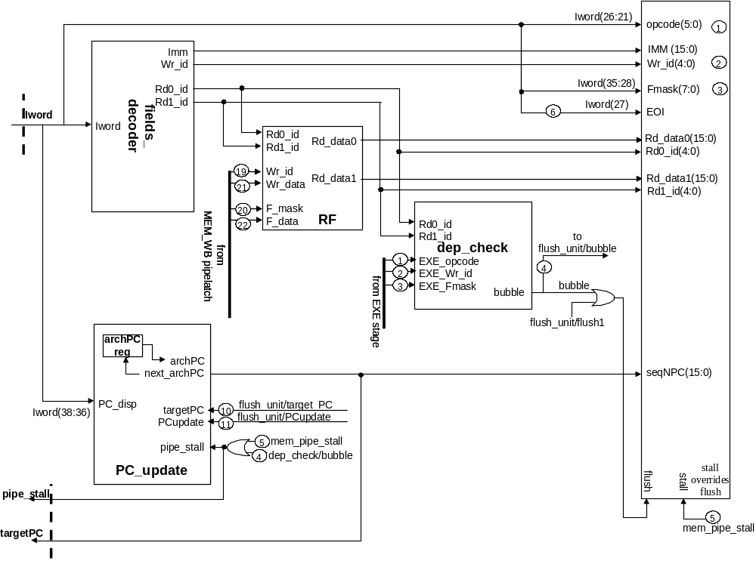
RF Stage

Slide 14
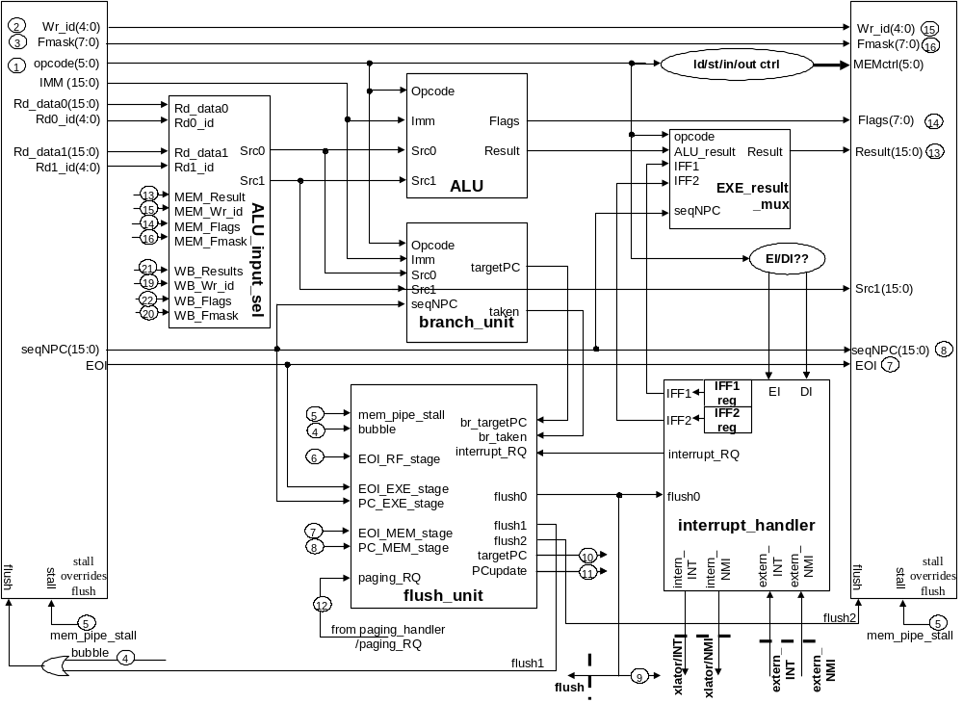
EXE Stage

Slide 15
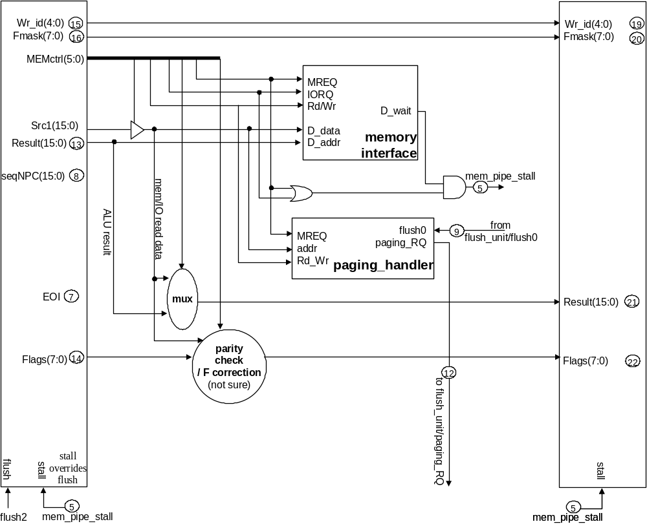
MEM Stage

Slide 16
Interrupts
IRQ (Maskable Interrupt)
  SMS is always used in interrupt mode 1. It causes a jump to location $0x0038 when an interrupt is generated
  A frame interrupt occurs every 1/60 second
NMI (Non Maskable Interrupt)
  Generated when the Pause button is pressed
  Causes an unconditional processor jump to address $0x0066

Slide 17
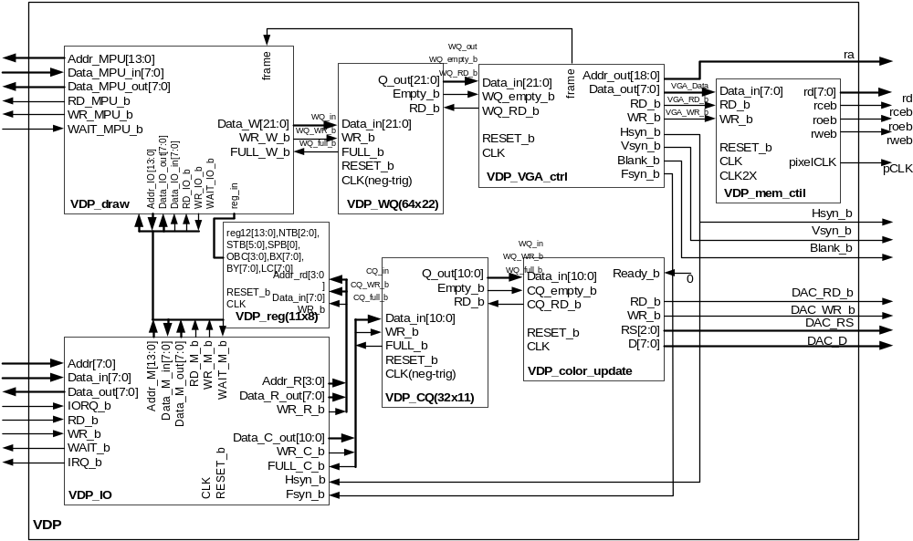
VDP

Slide 18
VDP Overview
Function:
  1) Memory RD/WR from CPU traffic
  2) Register RD/WR from CPU traffic
  3) Paint the screen based on defined memory location by register
  4) Interrupt generation
  5) Return current scan line information

Slide 19
VDP
Graphics Features
  256*192 resolution
  64 sprites on screen selected out of 512 possible tiles
  32 simultaneous colors out of 64
  Background Flipping (horizontal and vertical)
  Background Scrolling
  Relocatable sprite table
  Sprite data interleaving to allow a single write to change the color of the whole 8*8 sprite

Slide 20
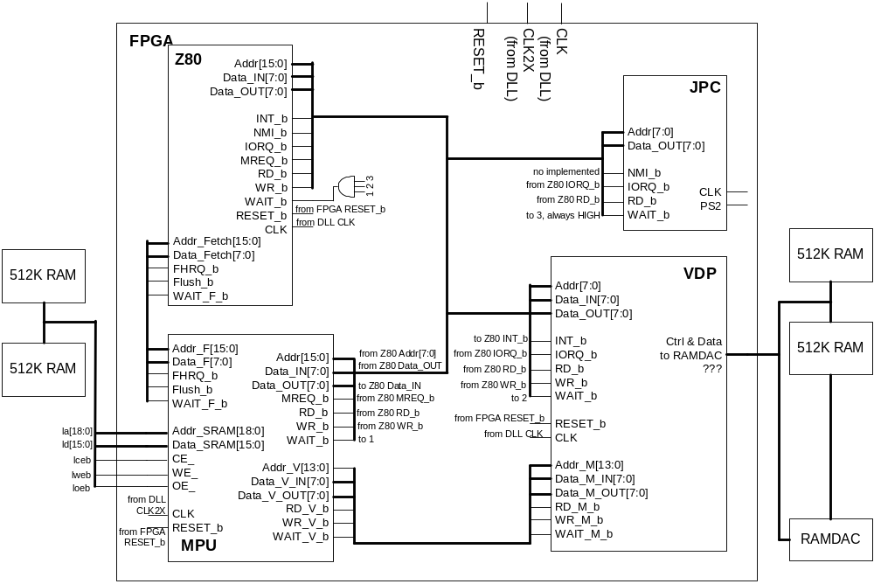
System I/O

Slide 21
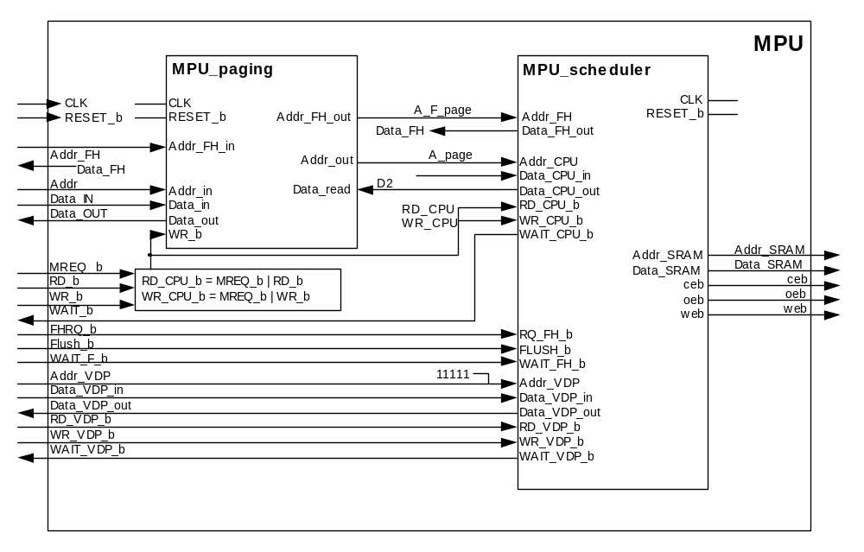
MPU (Memory Paging Unit)
5 MSB
0xxxxx (256K) SMS ROM
1xxxx (256K-last 54K) SMS Battery-Backed-Up RAM
11101 (16K) User RAM
11110 (4 bits) FCR (FFFC~FFFF)
11111 (16K) VDP Memory

Slide 22
Memory & I/O devices
All devices and memory share the same address bus and data bus.
For input/output type of instructions, Z80 sets IORQ. The lower 8-bit address is the port number, and data goes through the data bus.
For load type of instructions, Z80 sets MREQ. The 16-bit address is the virtual address and the data goes through the data bus.
Virtual address from Z80 is mapped to physical address by the memory paging chip.

Slide 23
Memory & I/O devices
Reason for Memory Paging
  Only 16-bit Address supported by Z80
  Need to handle up to 512 KB ROM + 16 KB RAM ( need more than 19 bits )
Memory Map summary
  On-board User RAM ( 8KB X 2 )
  ROM Frame 0, 1, 2 ( each 16KB of size )
  Frame Control Registers
Frame Control Registers (FCR’s)
  $FFFC : RAM select register
  $FFFD : Frame 0 ROM bank
  $FFFE : Frame 1 ROM bank
  $FFFF : Frame 2 ROM bank

Slide 24
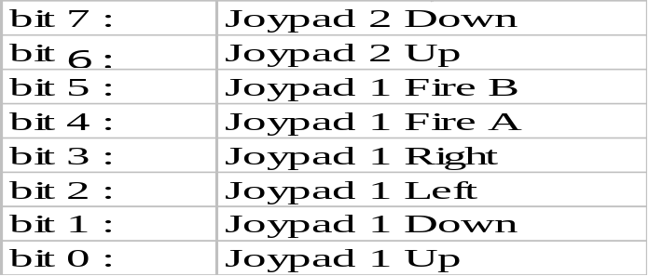
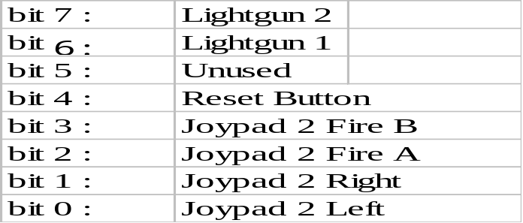
Joypad I/O
PORT $DC ($C0) – Joypad port 1 (read only)
  Each bit corresponds to a button
  0 for pressed, 1 for released
  Bits meaning :
PORT $DD ($C1) – Joypad port 2 (read only)
  Bits meaning :
Any kinds of Joypads are okay (serial or parallel)

Slide 25
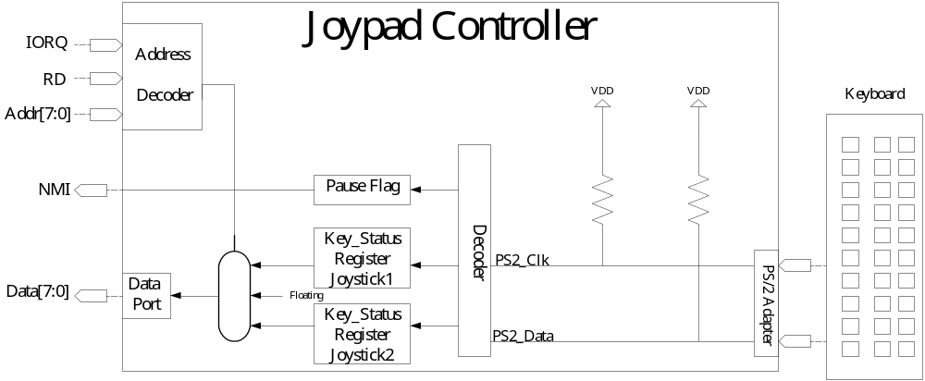
Joypad Controller (JPC Unit)
Proxy

Slide 26
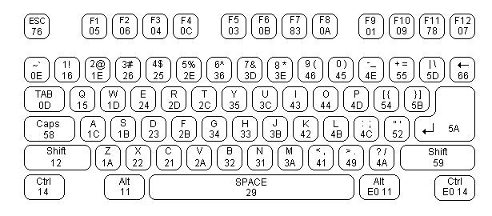
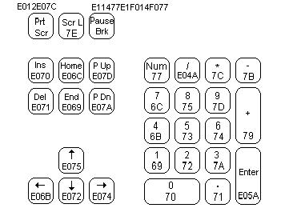
Joypad to Keyboard Mapping
 |  | Up | Down | Left | Right | FireA | FireB | Pause | Reset
Joy1 | Mapping Key | Ｗ | Ｓ | Ａ | Ｄ | < , | > . | F1 | ESC
 | Scan Code | 1D | 1B | 1C | 23 | 41 | 49 | 05 | 76
Joy2 | Mapping Key | ↑ | ↓ | ← | → | 0 Ins | . Del
 | Scan Code | E075 | E072 | E068 | E074 | 70 | 71

Slide 27
I/O Controller
Interacts with CPU,Scheduler,Color Ram.
Four Basic Operations.
Vramwrite, Vramread,Register Write , ColorRam write.
Interrupt Generation.

Slide 28
Functional Operation
On I/O request, fetches command word and data.
Decode
Command[15:14] 00:Read; 01:Write;10:Reg Wr;11:Cram
Line Interrupts
Frame Interrupts
Supports Pre-fetching on read

Slide 29
SMS Emulator
Z80 version
  Download the framework from web
  Reconstruct the Z80 CPU
Z80 Decoder
Z80 Core
VDP ( )
MPU ( )
JPC ( )
Memory ( )
SYS_IO ( )
Z80 CPU

Slide 30
SMS Emulator (Contd.)
Uop translator version
  Map the Verilog Translator to C++ code
  Implement the micro instruction set
Z80 Decoder
Z80 Core
VDP ( )
MPU ( )
JPC ( )
Memory ( )
SYS_IO ( )
Micro_I
Translator
RISC CPU

Slide 31
Miscellanea
Disassembler and profiler
  Z80 instruction decoder
  Every instruction is used
Debugging tools
  Virtual VDP and MEM
  Software interface with SPART
    With the range of Baud Rate: 9600 - 115200
  Bus traffic generator for VDP debugging
  Bus traffic playback based VDP

Slide 32
Processor Debugging Tools
Remote VDP / memory
  Originally, it was a part of plan B (no VDP)
  All memory / IO requests from the processor are sent to the software emulator through SPART (serial port, 57600 baud)
  captures all memory / IO traffics → comparison with software emulator
FPGA
Remote
VDP/mem
interface
z80
mem/IO
bus
VDP / mem
emulator
serial
port
trace
SPART
PC, addr, data

Slide 33
Processor Debugging Tools
Remote VDP/mem handshaking
  Processor sends PC, inst, addr to emulator
  Emulator echoes back to the processor for:
    flow control
    debugging break point
    communication error detection
Debugging issues
  Trace divergence for different timings

Slide 34
VDP Debugging: Steps
Steps in debug
1) Correct image painting
2) Left SRAM update:Correct image setup and attribute
3) Right SRAM update:Painting correct image
Use bus traffic and SRAM.v to dump memory for checking

Slide 35
VDP Debugging: Challenge
Using RAMDAC
  Not enough documentation: timing issue
  Color update takes several clock cycles
  Dark image-- not disabling ethernet port
Sprite Ordering: error in documentation(1st try show no sprite)
Bus traffic: Not a self contain command and data (sequence matter)

Slide 36
Demo
1) Emulator
  A) Translated Z-80 into u-ops
  B) Bus unit play back
2) Debugging tools:
  A) Modelsim and emulator tracer
  B) SPART version
3) Sega game system

Slide 37
Problems Encountered
VDP
  Documentation
  Core generated files
  Timing simulation accuracy
  Debugging issues
RISC core
  Memory interface issues
  Special Cases in instructions
Memory Controller

